Slide 1
Programmable In-network Security A vision for network security in the next generation
Ang Chen
University of Michigan

Slide 2










The modern life runs on network services
7am
8am
9am
…
Time
We rely on network services every day!

Slide 3












However, networks are plagued with attacks
'Internet Of Things' hacking attack led to widespread outage of popular websites
Power grid cyber attacks keep the Pentagon up at night
AWS outage knocks Amazon, Netflix, Tinder and IMDb in MEGA data collapse
Cyberattacks: Stuxnet and Flame
Amazon.com goes down, loses $66,240 per minute
Global DNS outage
hits Microsoft Azure customers
Gmail outage hits US, Europe
Internet shutdowns cost countries $2.4 billion last year
Skype calling knocked offline by major outage
Hacked home devices caused massive Internet outage
'Lizard Squad' took down Xbox Live
and PlayStation network
Azure Nightmare: Customer Suffers 9-Day Intermittent Outage
‘Maintenance' caused nationwide internet outage

Slide 4
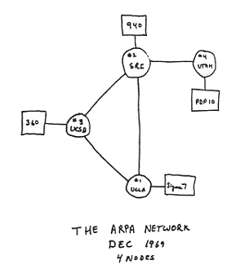
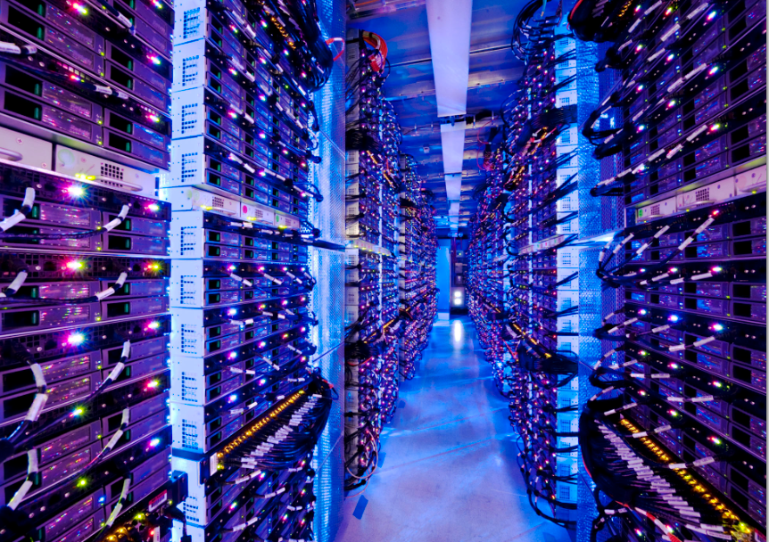
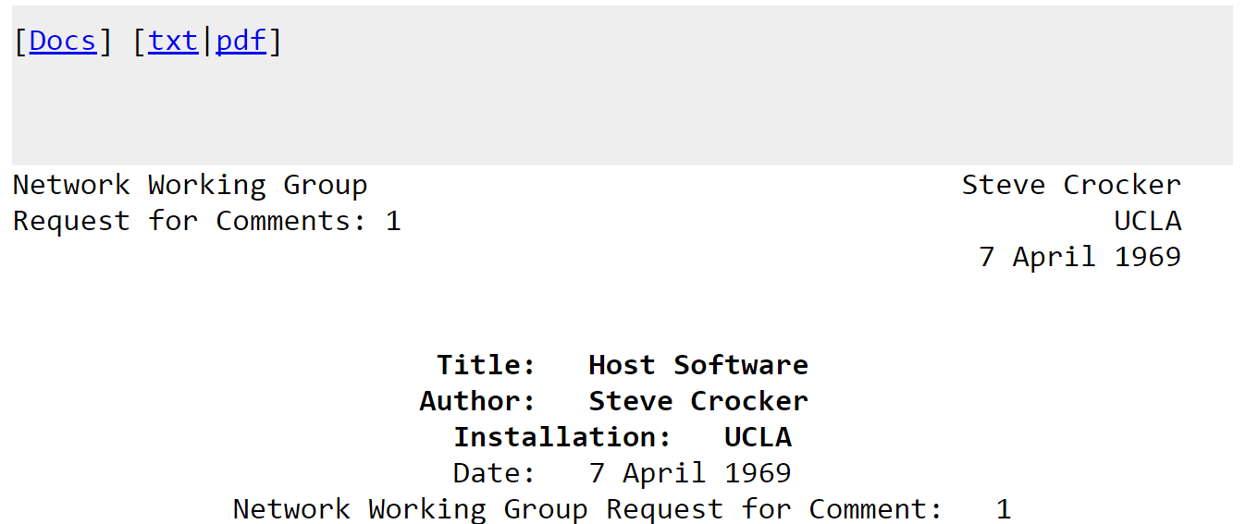
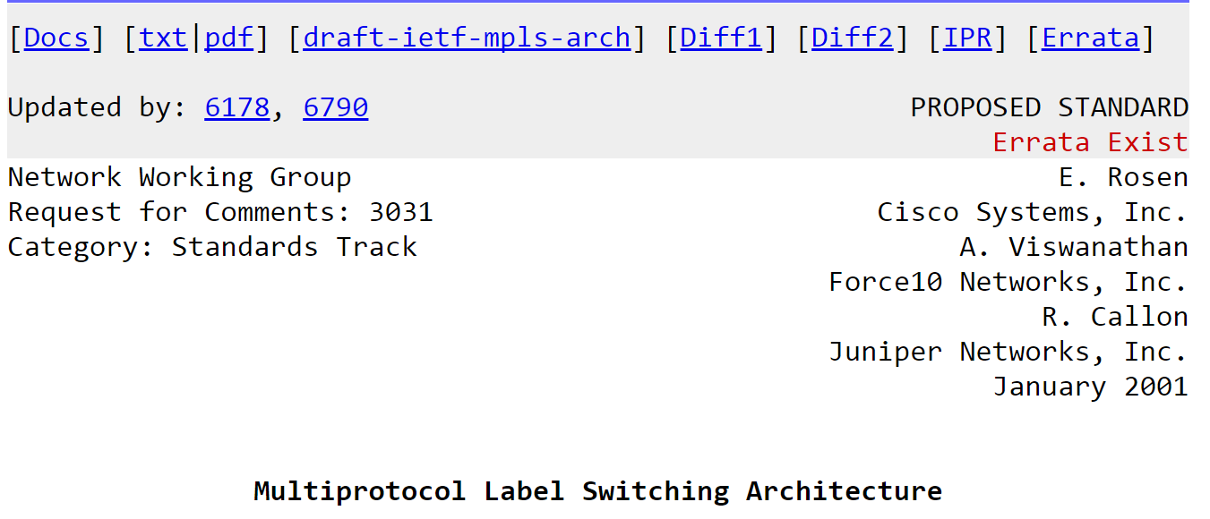
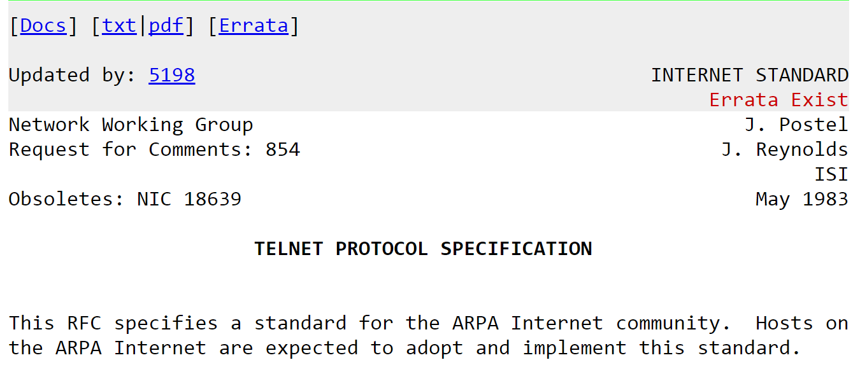
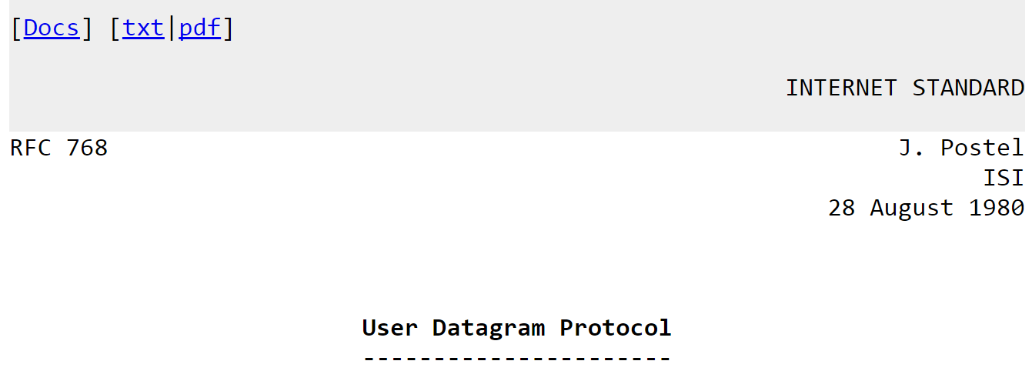
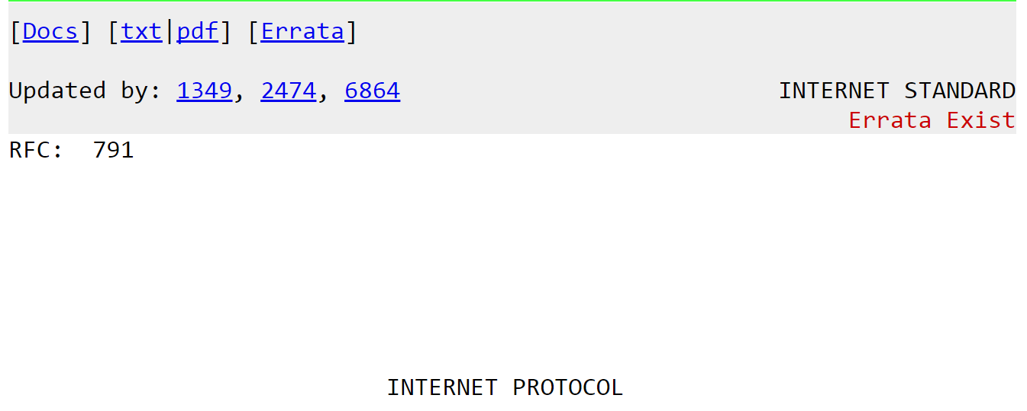
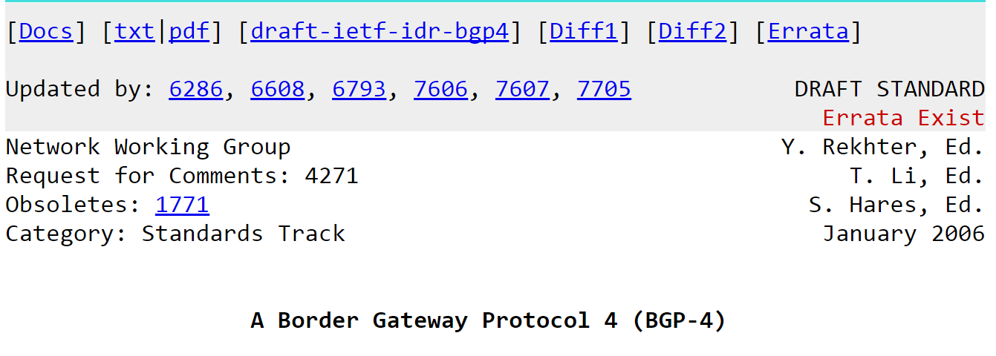
How did we get here?
1969
today
Networks have evolved significantly over the years

Slide 5
Challenge: network security
Our ability to secure them hasn’t caught up.
The network infrastructure itself doesn’t have security support
“The Internet is brittle and fragile and too easy to take down. It's a conduit for criminal activity.”
--- Vint Cerf

Slide 6







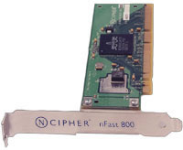



Today’s approach 1: Bolt-on protection
SYN flood
SYN cookie
Data exfiltration
Firewall
Attacks
Defenses
Keep networks unchanged, deploy protections elsewhere
E.g., middleboxes, end host software, ..
Advantage: Immediately practical
Disadvantage: Not a fundamental solution

Slide 7
Today’s approach 2: Clean slate design
Internet re-imagined!
Redesign the Internet to be secure
i.e., Future Internet Architectures
Advantage: Addresses the root cause
Disadvantage: Expensive changes

Slide 8
The best of both worlds?
Built-in security
Compatibility
Programmable In-network Security (Poise)
Architect security back to the network core
Without making intrusive modifications

Slide 9
Opportunity: Network programmability
Switch control plane
Programmable
Parser
PCIe bus
Programmable
Deparser
Memory
ALU
Match/
Action
Table
Match/
Action
Table
Stages
Stages
Match/
Action
Table
Programmable switches
Controlled in high-level languages (e.g., P4)
Customized protocols, persistent state, custom match/actions
All at linespeed (Tbps)!
We can develop defenses directly in the network!

Slide 10
Programming Protocol-independent Packet Processors
Programmer defines the tables and the exact processing algorithm
Programmer declares how the output packet will look on the wire
Programmer declares the headers that should be recognized and their order in the packet
Programmable Match-Action Pipeline
Programmable Deparser
Programmable Parser

Slide 11
P4 in Action
Packet is parsed into individual headers (parsed representation)
Headers and intermediate results can be used for matching and actions
Headers can be modified, added or removed
Packet is deparsed (serialized)
Programmable Match-Action Pipeline
Programmable Deparser
Programmable Parser

Slide 12
V1Model Standard Metadata
struct standard_metadata_t {
bit<9> ingress_port;
bit<9> egress_spec;
bit<9> egress_port;
bit<32> clone_spec;
bit<32> instance_type;
bit<1> drop;
bit<16> recirculate_port;
bit<32> packet_length;
bit<32> enq_timestamp;
bit<19> enq_qdepth;
bit<32> deq_timedelta;
bit<19> deq_qdepth;
bit<48> ingress_global_timestamp;
bit<32> lf_field_list;
bit<16> mcast_grp;
bit<1> resubmit_flag;
bit<16> egress_rid;
bit<1> checksum_error;
}
ingress_port - the port on which the packet arrived
egress_spec - the port to which the packet should be sent to

Slide 13
P4₁₆ Program Template (V1Model)
#include <core.p4>
#include <v1model.p4>
/* HEADERS */
struct metadata { ... }
struct headers {
ethernet_t ethernet;
ipv4_t ipv4;
}
/* PARSER */
parser MyParser(packet_in packet,
out headers hdr,
inout metadata meta,
inout standard_metadata_t smeta) {
...
}
/* CHECKSUM VERIFICATION */
control MyVerifyChecksum(in headers hdr,
inout metadata meta) {
...
}
/* INGRESS PROCESSING */
control MyIngress(inout headers hdr,
inout metadata meta,
inout standard_metadata_t std_meta) {
...
}
/* EGRESS PROCESSING */
control MyEgress(inout headers hdr,
inout metadata meta,
inout standard_metadata_t std_meta) {
...
}
/* CHECKSUM UPDATE */
control MyComputeChecksum(inout headers hdr,
inout metadata meta) {
...
}
/* DEPARSER */
control MyDeparser(inout headers hdr,
inout metadata meta) {
...
}
/* SWITCH */
V1Switch(
MyParser(),
MyVerifyChecksum(),
MyIngress(),
MyEgress(),
MyComputeChecksum(),
MyDeparser()
) main;

Slide 14
P4₁₆ Hello World (V1Model)
#include <core.p4>
#include <v1model.p4>
struct metadata {}
struct headers {}
parser MyParser(packet_in packet,
out headers hdr,
inout metadata meta,
inout standard_metadata_t standard_metadata) {
state start { transition accept; }
}
control MyVerifyChecksum(inout headers hdr, inout metadata meta) { apply { } }
control MyIngress(inout headers hdr,
inout metadata meta,
inout standard_metadata_t standard_metadata) {
apply {
if (standard_metadata.ingress_port == 1) {
standard_metadata.egress_spec = 2;
} else if (standard_metadata.ingress_port == 2) {
standard_metadata.egress_spec = 1;
}
}
}
control MyEgress(inout headers hdr,
inout metadata meta,
inout standard_metadata_t standard_metadata) {
apply { }
}
control MyComputeChecksum(inout headers hdr, inout metadata meta) {
apply { }
}
control MyDeparser(packet_out packet, in headers hdr) {
apply { }
}
V1Switch(
MyParser(),
MyVerifyChecksum(),
MyIngress(),
MyEgress(),
MyComputeChecksum(),
MyDeparser()
) main;

Slide 15
P4₁₆ Hello World (V1Model)
#include <core.p4>
#include <v1model.p4>
struct metadata {}
struct headers {}
parser MyParser(packet_in packet, out headers hdr,
inout metadata meta,
inout standard_metadata_t standard_metadata) {
state start { transition accept; }
}
control MyIngress(inout headers hdr, inout metadata meta,
inout standard_metadata_t standard_metadata) {
action set_egress_spec(bit<9> port) {
standard_metadata.egress_spec = port;
}
table forward {
key = { standard_metadata.ingress_port: exact; }
actions = {
set_egress_spec;
NoAction;
}
size = 1024;
default_action = NoAction();
}
apply { forward.apply(); }
}
control MyEgress(inout headers hdr,
inout metadata meta,
inout standard_metadata_t standard_metadata) {
apply { }
}
control MyVerifyChecksum(inout headers hdr, inout metadata meta) { apply { } }
control MyComputeChecksum(inout headers hdr, inout metadata meta) { apply { } }
control MyDeparser(packet_out packet, in headers hdr) {
apply { }
}
V1Switch( MyParser(), MyVerifyChecksum(), MyIngress(), MyEgress(), MyComputeChecksum(), MyDeparser() ) main;
Key | Action ID | Action Data
1 | set_egress_spec ID | 2
2 | set_egress_spec ID | 1

Slide 16
Poise vs. today’s software defenses
Per-packet visibility
Can detect needle-in-a-haystack attacks
Per-packet dynamicity
Can respond as fast as dynamic changing attacks
Scale-free defense
Naturally scales with network size and speed
Three key
advantages
At the same time, compatible with legacy networking

Slide 17




Roadmap: The switch as a defense platform
Security ”apps”
Step 1: Design a range of switch-based security defenses
Switches dynamically activate the needed defenses
Progress so far:
Data exfiltration via covert channels (USENIX Sec’20)
Access control, RDMA security (USENIX Sec’20+’22)..

Slide 18




Roadmap: The network as a defense fleet
A
C
E
D
F
B
Architect a wide range of defenses into network paths
Networks mitigate attacks as they route traffic
Progress so far: Link flooding attacks (USENIX Sec’21)

Slide 19



Roadmap: Securing the defenses
Switch program
......
If (cond)
foo ()
Else
bar ()
......
﻿Control.ingress:
Hardened program
......
If (cond)
foo ()
Else
bar ()
......
If(cond)
Else
TCP
UDP
foo()
bar()
Switch apps
Program analysis
Hardened apps
Ensure that security apps are themselves secure
Program analyses to gain high assurance
Progress so far: Adversarial trace discovery (ASPLOS’21)

Slide 20


Outline
Programmable In-network Security
The switch as a defense platform
Securing the switch apps
The network as a defense fleet
Future work
Summary

Slide 21







Motivation: Mitigating network covert channels
Launch code:
1011
TCP hdr: 1011
Ah! 1011
President
H E L L O
Launch code
Code is 1011
1
0
1
1
H
E
L
L
O
Attacker
Secretary
Network covert channels:
Storage channels: changing the packet header fields.
E.g., TCP ISN (1997), TTL (2004), Partial ACK (2009)
Timing channels: changing the timing of packets
E.g., IP-layer (2004), TCP-layer (2008), PHY-layer (2014)

Slide 22




Detection algorithms are never perfect
Known-good
distribution
or
?
Bimodal
due to channels
Observed trace
Consider network timing channels
Packet timing is non-deterministic
E.g., due to congestion, server processing speeds, ..
Approach: statistical tests against known-good traces
Can result in false positives/negatives
H
E
L
L
O

Slide 23

Mitigation algorithms hurt performance
Timing channel mitigation
E.g., Randomly delay packets to destroy timing modulation
Storage channel mitigation
E.g., scrub header fields by adding offset to TCP SEQs

Slide 24

Implication: Performance penalty
Channel defense
Existing defenses incur heavy performance penalty
Needs to process every single packet
→ Modern networks have high speeds (Tbps)
Imperfect detection leads to collateral damage
→ Normal traffic may be adversely impacted

Slide 25





Goal: Performance-preserving defenses
Software control plane
Packet caching
Statistical tests
Codesign
Hardware data plane
RTT
measurement
Per-flow state
maintenance
IPD
maintenance
Header
modification
NetWarden
Per-packet scrubbing at hardware speeds
Manipulate TCP congestion control to mask latency
Batch operations in software for TCP reliability

Slide 26

Per-packet defense
IPID: 1011
Seq: 1234
rwnd: 1234
H E L L O
H E L L O
H E L L O
Perf.
boosters
Conn1: 1234 -> 4321
Conn2: 9292 -> 7183
…
IPID: 1101
Seq: 4321
SRAM
rwnd: 4321
H E L L O
H E L L O
H E L L O
1. Stateless
2. Stateful
3. Non-deterministic
The P4 data plane performs per-packet defenses
Stateless: IPID, TTL, …
Stateful: TCP sequence number, ACK, ..
Non-deterministic: receive window, timing channels..

Slide 27

Manipulating TCP congestion control
data
data
ACK
ACK
data
data
ACK
data
ACK
Extra delay
Consider the timing channel defense:
Adding delay to packets disrupts TCP throughput
ACK boosters:
Optimistically ACK packets from the switch
Create the illusion of the same RTT for the sender

Slide 28
ACK boosters
①
③
⑤
Retransmission
②
④
NetWarden
Creates the illusion of the same RTT despite extra delay
(1) Measures (actual) RTT in data plane
(2) Generates ACK optimistically to trigger more data
(3) Caches extra packets for reliability
(4)-(5) Serves the client from the cache
Similar as a “performance-enhancing TCP proxy”
But accelerated in P4 hardware

Slide 29
Hardware/software codesign
Switch control plane
Computation: Batch operations
Memory: Growing state
Pkt cache
Stat. tests
Minimize crosstalk
Computation: Per-packet operations
Memory: Constant state
RTT
Flow state
IPDs
Header ops
Switch data plane
Challenge: P4 has a restricted programming model
Cannot perform statistical tests, packet caching ..
Solution: Division of labor between SW+HW
Principles are generally applicable to other defenses

Slide 30
Other techniques: Computing IPDs
insert(conn_id)
0-10us
11-20us
…
+1
21-30us
0-10us
21-30us
IPD Intervalization:
No per-pkt state
IPD Sketching:
No per-conn state
Challenges: for computing inter-packet gaps
Per-packet operations needed
But also accumulates state very fast (2B per packet)
Solution: two approximation techniques

Slide 31
Evaluation setup
NetWarden prototype:
Runs in Tofino Wedge 100BF-32X switch.
2500 LoC of P4 + 3000 LoC of C+Python
Threat model:
A compromised server + a trusted P4 switch running NetWarden
Leak a 2048-bit RSA key via covert channel.
Real world applications:
Apache servers, FTP servers, Nodejs servers
Baseline:
No defense: No covert channel defenses are deployed.
Naïve defense: Covert channel defenses without performance preservation

Slide 32
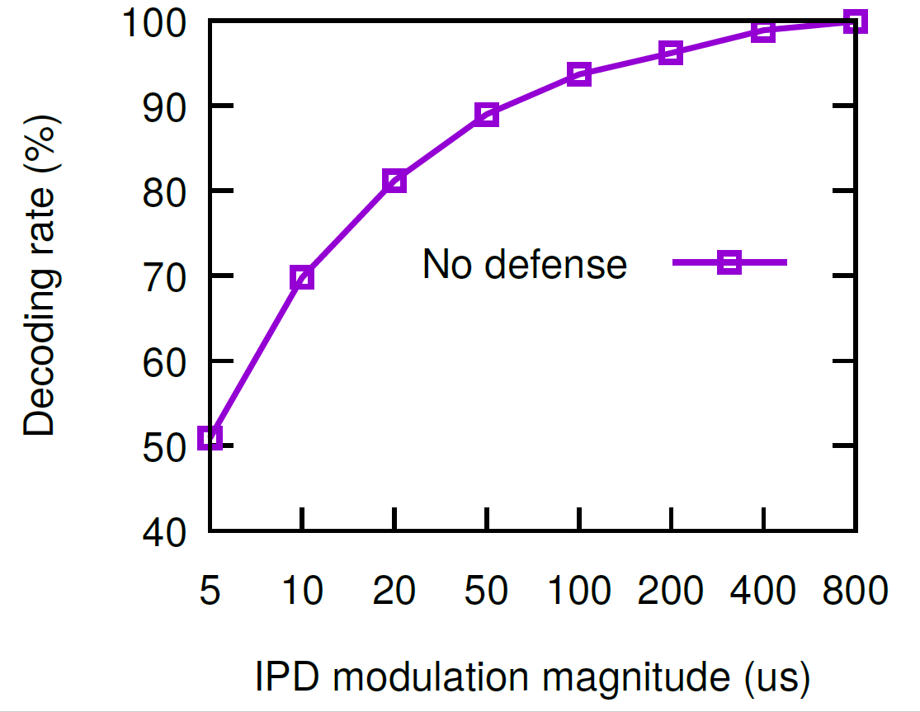
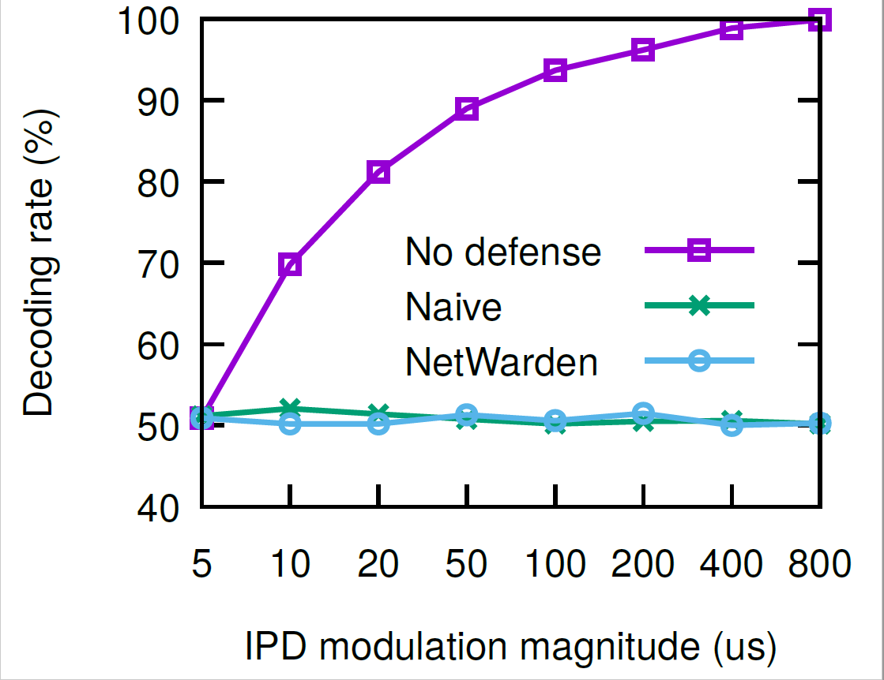
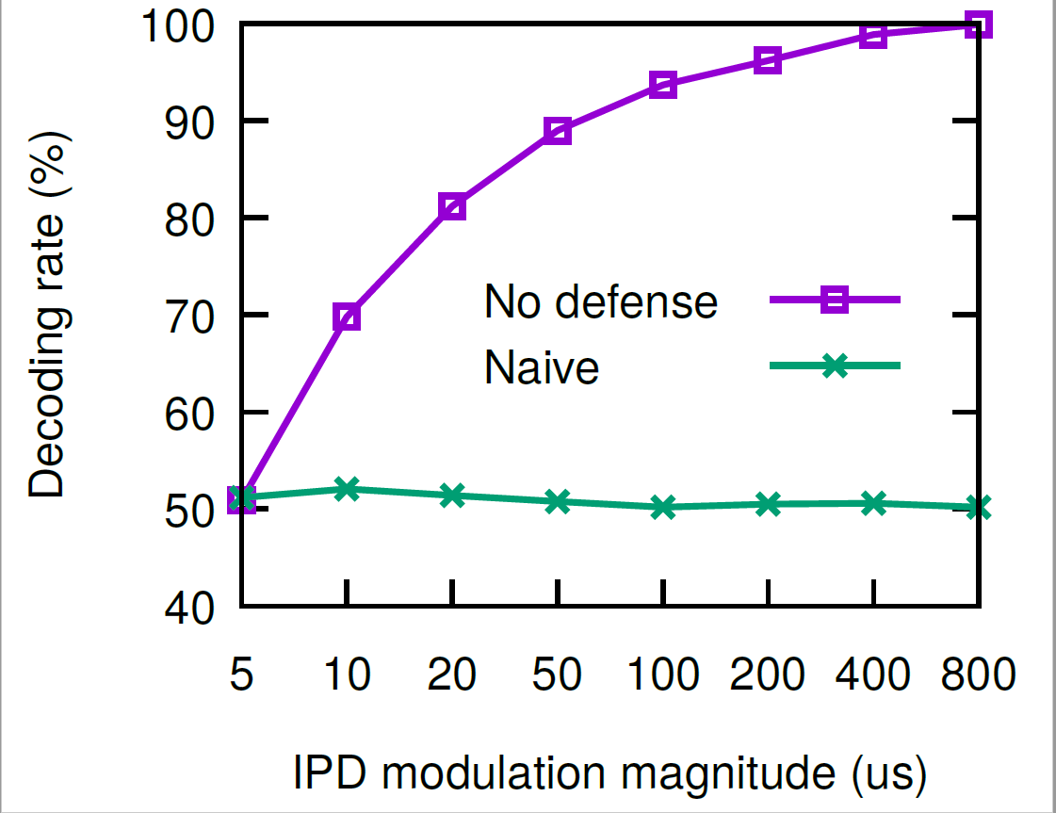
Defense effectiveness
Naïve defense: renders decoding to a random guess.
NetWarden: very close to a random guess.
→ Mitigates covert channels effectively.

Slide 33
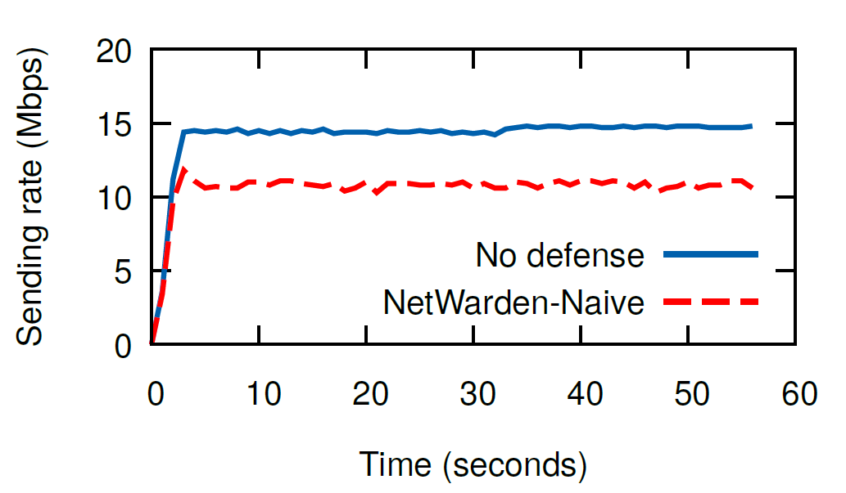
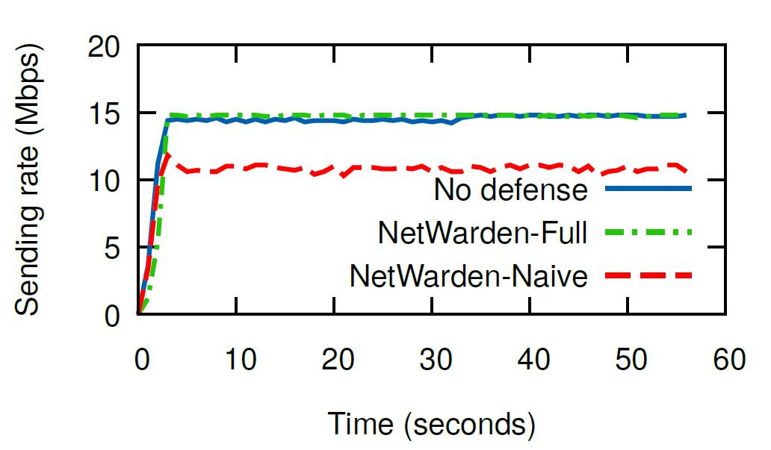
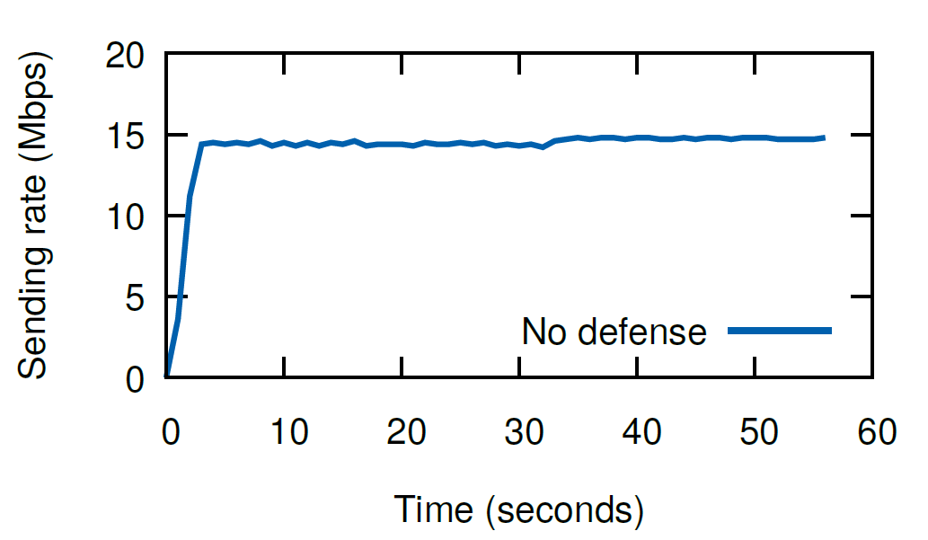
Performance preservation
No defense
NetWarden
Naive
No defense
Naive
Naïve defense incurs 25% performance penalty.
NetWarden only has 1% performance deviation
→ Mitigates channels with minimal performance loss.

Slide 34







Other results
System scalability
System overhead
Different TCP variants
Complex Applications
Self-defense techniques

Slide 35
Outline
Programmable In-network Security
The switch as a defense platform
The network as a defense fleet
Securing the defenses
Future work
Summary

Slide 36





Motivation: Network-wide attacks
Decoy servers
Actual victim
Decoy servers
Individual switches have local views, but global views and actions are needed
Example: Link-flooding attacks [USENIX Security’21]
Congest critical links to take down remote victim
Attackers can easily change traffic type, link target, ..

Slide 37


State of the art: SDN defenses
1
3
2
2
A central controller samples traffic, computes decisions, and installs rerouting/filtering rules
Limitation: Cannot handle dynamic attacks
Changing botnet composition
Changing traffic patterns
Changing target links

Slide 38
Ripple: A fully decentralized defense
Programmable switches coordinate in data plane
A panoramic view as defined in a policy language
Switches extract local signals, propagate them across the network, and reconstruct the global view

Slide 39
Ripple mitigates fast-changing attacks
Setup: Dynamic attacks based on “Crossfire” [SP ’13]
Baseline solutions: SDN variants
Ripple can mitigate attacks in real time, whereas SDN defenses constantly lag behind.

Slide 40
Outline
Programmable In-network Security
The switch as a defense platform
The network as a defense fleet
Securing the switch apps
Other work
Summary

Slide 41

Motivation: Adversarial testing
Switch apps
Automatically identify “adversarial traces” for a P4 system?
Example: We’ve manually done this for NetWarden
Adversarial traces exist for other P4 systems, too

Slide 42
Let’s look at another example
Per-flow table for 10.0.0.0/8
Routing table for 10.0.0.0/8
Packet
in
Flow tuples | Status
10.0.0.5:22 | Normal
10.0.0.8:22 | Retrans
Num. of retrans. flows
Path | Status
0 (primary) | Down
1 (backup) | Up
Packet
out
> X?
+1
Flow monitoring
Failure inference
Rerouting upon failure
Blink (NSDI 2019)
Goal: Infer remote link failures based on TCP retransmission
Monitors per-flow retransmission based on TCP SEQ
Uses sliding window to count retransmitting flows
Activates backup path if exceeds a threshold

Slide 43
Worst-case behavior analysis?
Switch program
......
If (cond)
foo ()
Else
bar ()
......
﻿Control.ingress:
Expected
distribution
If(cond)
Else
foo
bar
normal
retrans
foo()
bar()
Adversarial
distribution
foo
bar
Switch apps
Program analysis
Probabilistic profile
Intuition: Network programs have complex behaviors, and some are easier to process than others.

Slide 44

Starting point: Symbolic execution
ttl=10
packet_handler (pkt) {
pkt.ttl --;
if (pkt.ttl > 0) {
forward packet
} else {
drop packet
}
}
ttl=x
ttl=9
ttl=x-1
ttl=9
x-1>0
x-1<=0
SMT solver
Concrete/normal
execution
Symbolic
execution
Goal: Enumerate program behaviors and generate inputs for each behavior
Create symbolic inputs and collect symbolic constraints
Fork execution paths for branch and loop conditions
Invoke solver to compute satisfying assignments

Slide 45
Symbolic execution is not enough
﻿Control.ingress:
+1
packet_handler (pkt) {
pkt_cnt ++;
if (pkt_cnt == 1M) {
//sample packet
}
If(cond)
Else
+1
Loop
body
normal
retrans
foo()
bar()
+1
Computing probabilities
Hash tables, sketches, bloom filters
Stateful loops
Computing probabilities
Handling approximate data structures
Handling stateful loops

Slide 46
From executions to probabilities
TCP traffic
Other traffic
Retransmissions
Behavior 3
Normal trans
Behavior 4
The entire header space
Approach: Count the # of satisfying solutions
All possible header values form a “headerspace”
Program executions produce subspaces
Prob = Volume(subspace)/Volume(headerspace)
Model counting solvers, or by querying network traces

Slide 47
Handling approximate data structures
?
A[x].insert(v1);
…
A[x].insert(v2);
…
A[x].insert(v3);
?
CRC(flowkey)
?
Modeling a hash table as a symbolic array
State-of-the-art technique: Symbolic arrays
A symbolic access may fall on any array locations
Create execution paths to capture uncertainty
Doesn’t scale with array size
Typical sketches: O(10k) elements

Slide 48
Solution: Greybox analysis
Modeling a ‘insert(v3)’ operation
[ (v1, p1), (v2, p2)]
Size = k, max = N
Pr(Hit) = HitRate(k,N)
Pr(Col) = ColRate(k,N)
Pr(Empty) = (N-k) / N
[ (v1, q1), (v2, q2), (v3, q3)]
Size = k, max = N
[ (v1, p1), (v2, p2), (v3, p3)]
Size = k + 1, max = N
p1 = (p1 * k) / (k + 1)
p2 = (p2 * k) / (k + 1)
p3 = 1 / (k + 1)
[ (v1, a1), (v2, a2), (v3, a3)]
Size = k, max = N
Approach: Use statistical properties of the approximate data structures to model abstract behaviors
Keep “probabilistic” state distribution instead of actual state
Scales independently of the array size

Slide 49
Handling stateful loops
packet_handler (pkt) {
//identify TCP pkts
tcp_pkt_cnt ++;
if (tcp_pkt_cnt == 1M) {
//sample packet
}
p1.proto=6
p1.proto!=6
Loop
body
p2.proto=6
!=6
=6
!=6
p3.proto=6
Stateful loops
Path constraints
…
…
P4 programs are executed in an “implicit” loop
Every packet triggers the loop execution once
One execution impacts the next via stateful variables
Naïve solution needs a long sequence of symbolic packets
K branches, t packets: O(K^t) execution paths

Slide 50
Solution: Telescoping
p1.proto=6
p1.proto!=6
p2.proto=6
!=6
=6
!=6
p3.proto=6
Path constraints
…
…
Observation: Periodic loop behaviors are common in P4 programs due to event monitors
Use a short symbolic packet sequence as probe
Analyze which execution paths lead to monitor increments
Stretch/repeat the short sequence into a longer one
Compute probabilities based on stretched sequence

Slide 51
Evaluation setup
P4wn prototype:
6500 LoC of C
Extends the KLEE symbolic execution engine
A range of programs
Stateless ones in Vera (SIGCOMM’18)
Stateful ones in recent work
NetWarden, Blink, …
Baseline:
KLEE

Slide 52
Microbenchmarks: Greybox analysis
P4wn scales independently of data structure size
Figure for CMS; other results in paper

Slide 53
Microbenchmarks: Telescoping
P4wn uses 4 symbolic packets for telescoping
Figure for Blink; other results in paper

Slide 54
Probabilistic profiles + adversarial testing
System | Description | Adversarial trace(s)
Blink [NSDI’19] | Link failure detector | Concurrent TCP retrans.
NetCache [SOSP’17] | Key/value cache | Changing “hot” keys
*Flow [ATC’18] | Network telemetry | Frequent collision
P40f [CoNEXT’19] | OS fingerprinting | Signature mismatch
NetHCF [ICNP’19] | Spoofed traffic filtering | Frequent unseen IPs
Poise [Sec’20] | Access control | Hash collisions (+)
NetWarden [Sec’20] | Covert channel defense | Timing modulation (+)
Method: Rank code blocks by probability, and generate test traces to lowest ones
P4wn detected all known adversarial traces in the tested systems

Slide 55

Where to go from here?
Programmable In-network Security (Poise)
The switch as a defense platform
Securing the switch apps
The network as a defense fleet

Slide 56
The Poise “network security stack”
The “narrow waist” of the network security stack
ISA-like primitives for security
Small building blocks, verifiable
Recomposable for different tasks
Dynamically swapped in and out for defense

Slide 57
Need to add runtime flexibility!
Network program
......
Control ingress{
tab.apply ()
…
} ......
p4c compiler
Compile-time programmability
app.p4
P4 switch
Operators compile and reflash a new program
Causes data plane disruption, so need to provision for that
Drain and undrain traffic for any data plane changes
Expensive to plan and perform, constrains change velocity

Slide 58








Runtime programmable networks
Runtime network (re)programming end-to-end
No downtime, zero packet loss, consistency guarantees
Users can inject real-time “network extensions”

Slide 59
Why runtime programmable networks?
A
C
E
D
F
B
Use case: Real-time security defense
Network devices swaps defenses in and out
Defenses dynamically migrate across the network
They shapeshift in real time for changing attacks

Slide 60
Why runtime programmable networks?
Just-in-time network optimization
Common mode: Basic routing, low latency
JIT optimization based on applications and workloads
Tenant-specific extensions
Tenant directly customize network logic
Incremental infrastructure upgrades
Coordinated changes at NICs, switches, and hosts
Ex: new congestion control algorithms

Slide 61
Why now?
Individual targets are becoming runtime programmable
Ex: Runtime programmable switches (NSDI’22)
Dynamically add/remove/modify tables, control flow, parsers
Prototyped on a 12.8Tbps ASIC
Ex: Runtime programmable SmartNICs (ongoing)
Ex: Host networking based on eBPF

Slide 62
The overall vision
Brand new challenges and opportunities ahead!

Slide 63
Summary
Motivation: Next-generation network security
Approach: Programmable In-network security
Architect security back into the network foundation
We have already made some progress:
A switch as a defense platform
A network as a defense fleet
Securing the defenses
More opportunities await!
Thank you!

